Slide 1

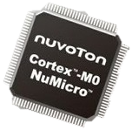
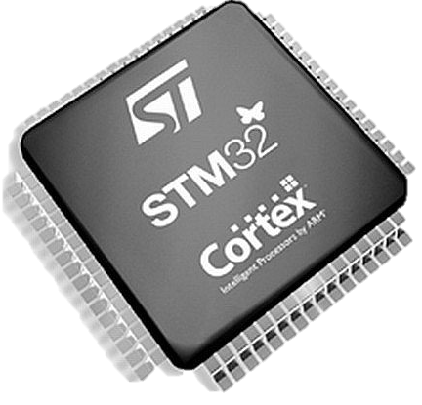
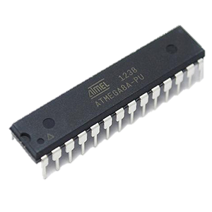

Embedded Programming
Amizzuddin Amin

Slide 2
Table of Content
Reference
RECAP – Digital Output / Input
RECAP – Analog Output / Input
Digital / Analog pins available on Arduino
UART communication
Electronics equipment
Programming skill
Ternary operator
Object Oriented Programming (OOP)
Exercises

Slide 3
Reference
Thinkercad account (Link)
Getting started with Arduino ebook (Link)
C programming for Arduino ebook (Link)
Arduino Reference website (Link)
C++ reference (Link)
Amizzuddin’s github (Link)
For later part of the module (day 3 and 4)
Purpose to enhance your programming language skill
Arduino cheat sheet (Link)
Arduino pin mapping (Link)
Return to Table of Content

Slide 4
Recap - Digital Output/Input
Step up:
Initialize pin => Set the pinMode(pin, mode);
pin refers to the selected Arduino pin number
mode refers to digital pin mode [INPUT, INPUT_PULLUP or OUTPUT]
INPUT_PULLUP is used when no resistor is connected with the input pin. However, do note that different microcontroller have different pullup resistor values (Link)
Digital Output [ pinMode(pin, OUTPUT) ] => digitalWrite(pin, value);
pin refers to the selected Arduino pin to write the output value
value refers the digital value to write to the pin [HIGH or LOW]
HIGH = 5v and LOW = GND/ 0v
Digital Input [ pinMode(pin, INPUT) ] => digitalRead(pin);
pin refers to the selected Arduino pin to read the input value
Input value can either be HIGH (voltage > 3.0v) or LOW (voltage < 1.5v) (Link)
Return to Table of Content

Slide 5
Example
INPUT
OUTPUT
//INPUT_PIN= Arduino pin 2
#define INPUT_PIN 2
void setup(){
pinMode(INPUT_PIN, INPUT);
}
void loop(){
bool read_input = digitalRead(INPUT_PIN);
}
//OUTPUT_PIN= Arduino pin 13
#define OUTPUT_PIN 13
void setup(){
pinMode(OUTPUT_PIN, OUTPUT);
}
void loop(){
digitalWrite(OUTPUT_PIN, HIGH);
delay(500); //do nothing for 500msec
digitalWrite(OUTPUT_PIN, LOW);
delay(500); //do nothing for 500msec
}
Program reads input from Arduino pin 2 and store the read value into variable label read_input which only stores value of HIGH or LOW(bool data_type)
Program write blink LED on Arduino board (label as “L”) every 500msec (50% duty cycle)
Return to Table of Content

Slide 6
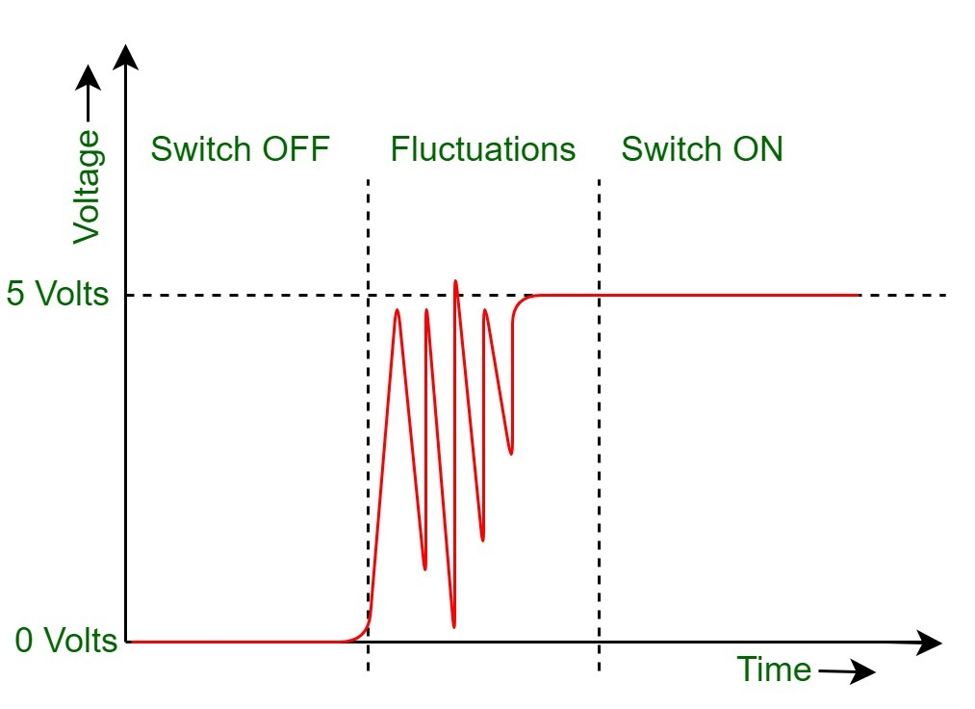
Switch Debounce
Problems arises when you intend to do a counter that counts up every time button is pressed. Due to the noise, microcontroller detects multiple pressed when in actual, the button is pressed once.
To solve these, one can do the following:
By Software
By Hardware
You can read more here how this is done
The moment button is pressed
Microcontroller detects multiple series of ONs and OFFs
Return to Table of Content

Slide 7
Recap - Analog Output/Input
Step up:
Initialize pin => Set the pinMode(pin, mode);
pin refers to the selected Arduino pin number
mode refers to digital pin mode [INPUT, INPUT_PULLUP or OUTPUT]
INPUT_PULLUP is used when no resistor is connected with the input pin. However, do note that different microcontroller have different pullup resistor values (Link)
Analog Output [ pinMode(pin, OUTPUT) ] => analogWrite(pin, value);
pin refers to the selected Arduino pin to write the output value
value refers the digital value to write to the pin [0 to 255] (Link)
PWM Duty cycle formula= (value/255) * 100% (PWM)
Analog Input [ pinMode(pin, INPUT) ] => analogRead(pin);
pin refers to the selected Arduino pin to read the input value
Input value range from 0 to 1023(Link)
Return to Table of Content

Slide 8
Example
INPUT
OUTPUT
//POTENTIOMETER = Arduino pin A0
#define POTENTIOMETER A0
void setup(){
pinMode(POTENTIOMETER, INPUT);
}
void loop(){
int analog_value = analogRead(POTENTIOMETER);
}
//OUTPUT_PIN = Arduino pin 9
#define LED_PIN 9
#define MAX_BRIGHTNESS 255
void setup(){
pinMode(LED_PIN, OUTPUT);
}
void loop(){
for(int brightness = 0; brightness < MAX_BRIGHTNESS; brightness++){
analogWrite(LED_PIN, brightness);
delay(500); //do nothing for 500msec
}
}
Program reads potentiometer connected to Arduino pin A0 and store the read value into variable label analog_value with possible values of 0 - 1023(Link)
Program write LED on pin 9 shine brighter for every 500msec. After 128 seconds later the LED will turn off and the brightness cycle will continue.
Return to Table of Content

Slide 9
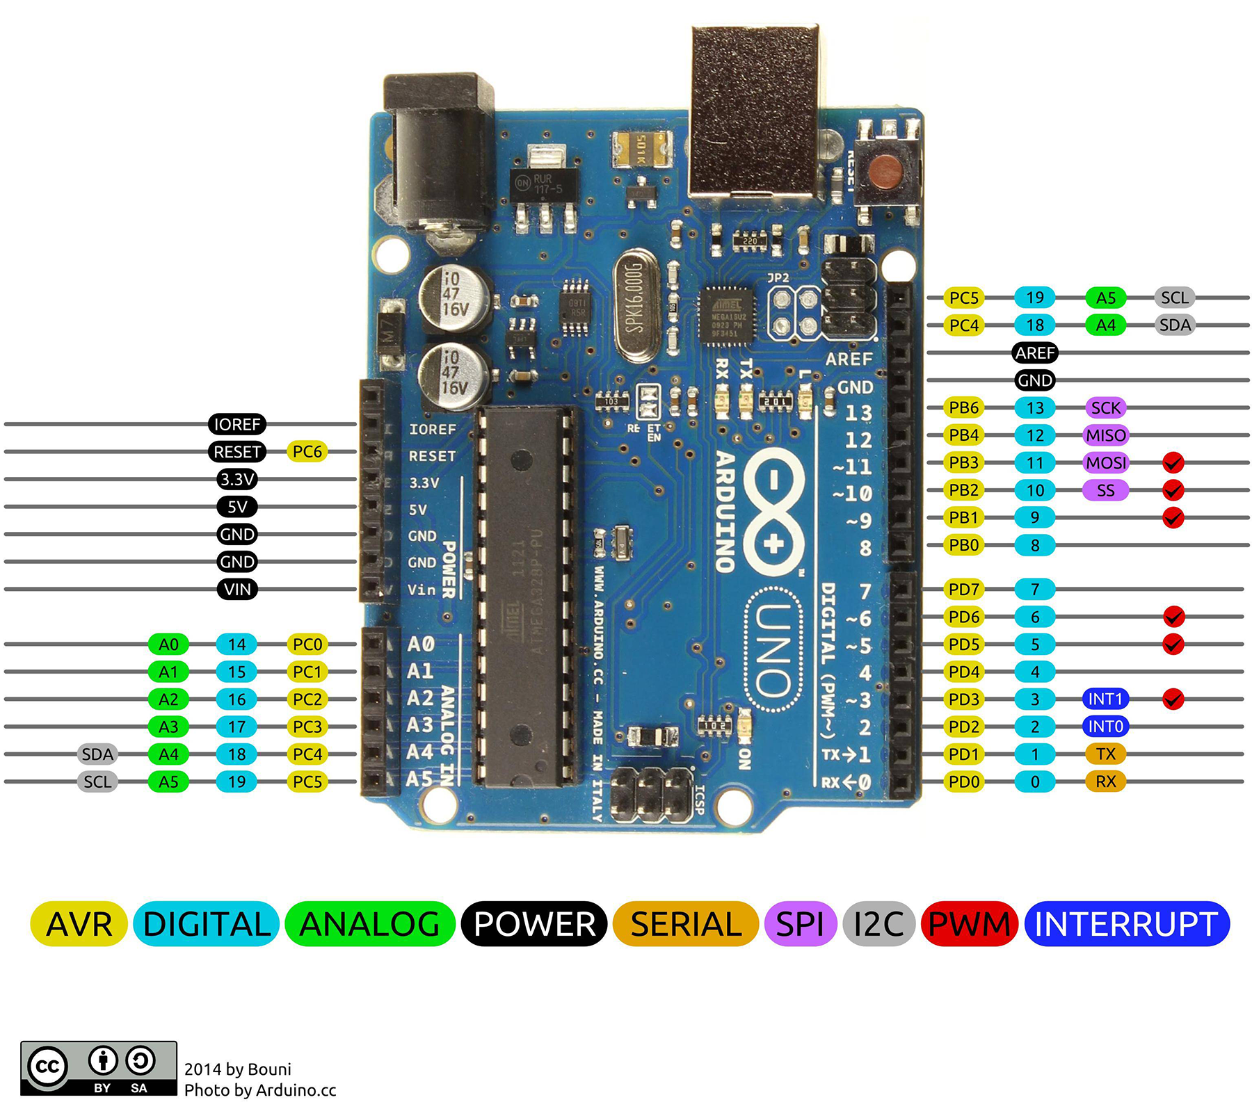
Digital / Analog pins available on Arduino
Legend:
analogWrite(pin, value);
analogRead(pin);
digitalWrite(pin, value);
digitalRead(pin);
Return to Table of Content

Slide 10
UART communication
Step up:
Initialize communication => Serial.begin(Baudrate);
Baudrate refers speed of communication between devices(Link)
Check incoming data availability => Serial.availability();
Function returns the number of byte that is available in the serial_buffer(Link)
Read data => Serial.read();
Function reads a byte of data in the serial buffer. Data received is in ASCII code. (Link)
Transmit data => Serial.print(); / Serial.write();
Serial.print() prints data to the serial port in ASCII text. (Link)
Serial.write() writes binary data to the serial port (Link)
Return to Table of Content

Slide 11
Parsing receiving data
One of the challenges with UART communication is to determine how useful the data to the application.
Example: When a series of incoming data received in the serial port, How one make these data into usable command?
The solve this, both device must establish a standard protocol of communication.
Example:Transmit device can add separator marker to indicate value representation. GPS uses this type of separator as well (Link)
The next slide will provide a simple way to parse data from UART communication
Return to Table of Content

Slide 12
Parsing receiving data
Transmit Device
Receiving Device
Transmitter must know the type of data/commands that the receiver requires.
If receiver requires more than one data/command, data can be separated using separator marker (‘ , ‘)
Receiver must be able to process data quick enough to prevent loss of data due to slow processing upon receiving data from transmitter. This is very important especially for sensitive data such as aircraft airspeed, altitude and more.
Receiver must know when reject data when data is invalid.
Sample function can be download here
Return to Table of Content

Slide 13
Flowchart of serial_data_control() function
Is char numeric?
Data received in Serial buffer
Read one char
Is char alphabet?
Is char ‘,’ or no more data in buffer?
Convert to decimal and store
Is char ‘,’ or no more data in buffer?
Any store value?
Read buffer but don’t store
store value = 0
Return the store value
Return to Table of Content

Slide 14
Electronics instrument
Oscilloscope
Reads the signal from Arduino pin
Plots the waveform from Arduino pin
Multimeter
Read resistance, voltage or current
Power supply NOT connected
Measure voltage = measuring probe connected parallel to component intend to measure
Power supply connected
Measure voltage = measuring probe connected parallel to component intend to measure
Measure current = measuring probe connected series to component intend to measure
Function generator
Supplies signal such as sinewave, sawtooth wave, squarewave and triangle wave. (Commonly use for radio circuits)
Power supply
Supplies voltage or current at the desired value
Return to Table of Content

Slide 15
Programming Skill – Ternary Operator
If… Else.. statement
Ternary operator
//OUTPUT_PIN = Arduino pin 9
#define LED_PIN 9
#define MAX_BRIGHTNESS 255
int brightness = 0;
void setup(){
pinMode(LED_PIN, OUTPUT);
}
void loop(){
if(brightness < MAX_BRIGHTNESS){
brightness = brightness + 1;
}
else{
brightness = 0;
}
analogWrite(LED_PIN, brightness);
delay(500); //do nothing for 500msec
}
//OUTPUT_PIN = Arduino pin 9
#define LED_PIN 9
#define MAX_BRIGHTNESS 255
int brightness = 0;
void setup(){
pinMode(LED_PIN, OUTPUT);
}
void loop(){
brightness = (brightness < MAX_BRIGHTNESS) ? brightness + 1 : 0;
analogWrite(LED_PIN, brightness);
delay(500); //do nothing for 500msec
}
Return to Table of Content

Slide 16
Programming Skill – Ternary Operator
Both of the program behaves the same way. Its just the way of writing the code.
Unlike if… else.. Statement, ternary operator is suitable for dealing value assignment for single variable. However, if you have variables need to change values at a given condition, its better to use if… else.. Statement for readability.
For more information on ternary operator you may visit the following link.
Ternary operator can be use on other programming language but the syntax may not look different. Example ternary operator on python is done this way:
Brightness = ( brightness + 1, 0) [brightness < MAX_BRIGHTNESS]
Return to Table of Content

Slide 17
Programming Skill – Object Oriented Programming (OOP)
It is a programming model that organizes program as object.
Object is defined as data with a certain unique attributes and behaviour.
Example:
Object “employee” can have the following attributes:
Division
Department
Designation
The benefits of OOP includes the following:
Reusability
Efficiency
scalability
Return to Table of Content

Slide 18
Programming Skill – Object Oriented Programming (OOP)
It is a programming model that organizes program as object.
Object is defined as data with a certain unique attributes and behaviour.
Example:
Object “employee” can have the following attributes:
Division
Department
Designation
The benefits of OOP includes the following:
Reusability
Efficiency
scalability
Return to Table of Content

Slide 19
Visualizing a class in C++
Class (employee)
Access Specifier (employee salary)
Members function
(department and devision)
Data members (Name and designation)
Constructor (parameters)
Return to Table of Content

Slide 20
Example: Pushbutton Class
Class (Pushbutton)
Private members
- counter_value;
- Debounce_duration;
- toggle_value;
- lastDebounce;
- buttonState;
Constructor
(Pin number)
Public members
- initialize()
- read()
- change_of_state()
- toggle()
- clickers()
Return to Table of Content

Slide 21
L293N Truth table
Decimal | INA | INB | INC | IND | Motor direction | EN
0 | 0 | 0 | 0 | 0 | Stop | The enable input is used to control the speed of motor. To control speed of motor can be done using PWM (analogWrite(pin, value)) function.
1 | 0 | 0 | 0 | 1 | Radial turn
2 | 0 | 0 | 1 | 0 | Radial turn
3 | 0 | 0 | 1 | 1 | Stop
4 | 0 | 1 | 0 | 0 | Anti-clockwise
5 | 0 | 1 | 0 | 1 | Forward
6 | 0 | 1 | 1 | 0 | Spot turn
7 | 0 | 1 | 1 | 1 | Radial turn
8 | 1 | 0 | 0 | 0 | Clockwise
9 | 1 | 0 | 0 | 1 | Reverse
10 | 1 | 0 | 1 | 0 | Forward
11 | 1 | 0 | 1 | 1 | Radial turn
12 | 1 | 1 | 0 | 0 | Stop
13 | 1 | 1 | 0 | 1 | Radial Turn
14 | 1 | 1 | 1 | 0 | Radial Turn
15 | 1 | 1 | 1 | 1 | Stop
Return to Table of Content

Slide 22
Beginner level Practice
Control LED brightness using Potentiometer.
Control 3 LED blink using pushbutton such that it replicates a traffic light.
Control motor direction using the code develop from practice 2
Control motor speed using potentiometer using the code develop from practice 1 (motor turn anti-clockwise)
Combine codes from practice 3 and 4. Are you able to control both speed and direction of motor using pushbutton and potentiometer?
Tip: you can use the map() function to make data conversion from potentiometer to control motor speed

Slide 23
Intermediate level Practice
Control 3 LED blink using serial communication such that it replicates a traffic light.
Control LED brightness using serial communication
Control the motor direction and speed using serial communication.
Tip: You can use this function to simplify your development for serial communication.

Slide 24
Advance level Practice
Control multiple servo to replicate Robotic arm via serial communication.
Display string on LCD display via serial communication.
Tip: You may use this function to simplify your serial communication development.

Slide 25
Practice Solution
Basic
Link
Link
Link
Link
Link (with class Link)
Intermediate
Link
Link
Link
Advance
Link
Link
Extra
Dual motor control (pushbutton and potentiometer) – using class
Parsing serial communication (accept only numeric values)

